Slide 1

IMAGE CAPTIONING
-By Sandipta Subir Khare
Priyanka Biswas
Shinakshi Sankhayan
Gulfairus Kairedenova

Slide 2
PROBLEM STATEMENT
Now days, if someone see the image and not able to recognise what image is showing. Then in that Scanerio Image Captioning would help the user to get the final output of the image.
If there is an user with medical conditions like blind and paralysis then they might able to use any technology for recognising the image. Our project Image Captioning with Voice recognition would help the user to get the final output.

Slide 3
OBJECTIVES OF IMAGE CAPTIONING
Image caption, automatically generating natural language descriptions according to the content observed in an image, is an important part of scene understanding, which combines the knowledge of computer vision and natural language processing. The application of image caption is extensive and significant, for example, the realization of human-computer interaction.

Slide 4
WHAT IS IMAGE CAPTIONING?
Image Captioning is the process of generating textual description of an image. It uses Machine Learning, Deep Learning, Natural Language Processing and Computer Vision to generate the captions. The dataset will be in the form [image → captions]. The dataset consists of input images and their corresponding output captions.

Slide 5
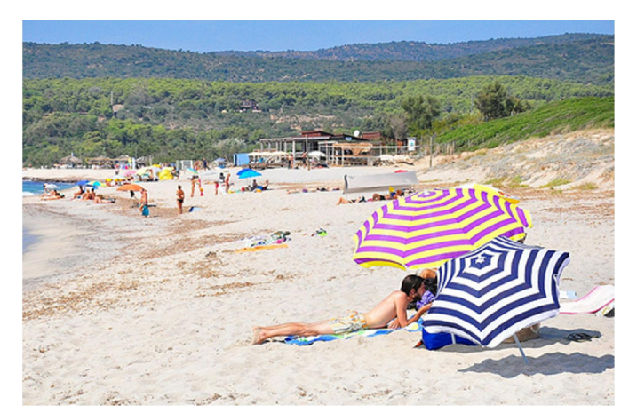
Here, you would see the image. Without the help of software you would see that the image is telling that there are few attributes:
Umbrella
Beach
Sunny Day
People Laying on Sand
Blue Sky
Green Mountains

Slide 6
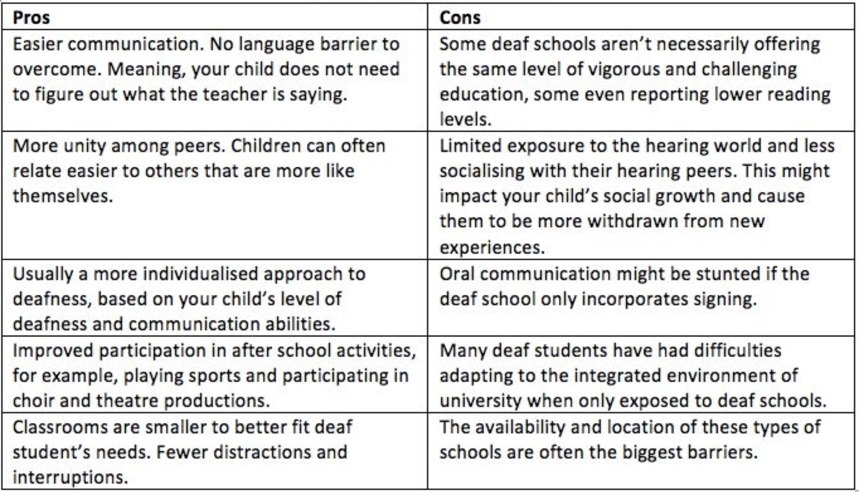
PROS AND CONS OF IMAGE CAPTIONING

Slide 7
HOW TO DO IMAGE CAPTIONING IMPLEMENTATION?

Slide 8
As a fundamental problem in image understanding, image caption generation has attracted much attention from both computer vision and natural language processing communities. We will focus on how to exploit the structure information of a natural sentence, which is used to describe the content of an image. We discover that the Part of Speech (PoS) tags of a sentence, are very effective cues for guiding the Long Short-Term Memory (LSTM) based word generator. More specifically, given a sentence, the PoS tag of each word is utilized to determine whether it is essential to input image representation into the word generator. Benefiting from such a strategy, our model can closely connect the visual attributes of an image to the word concepts in the natural language space.

Slide 9
IMPLEMENTATION
The task of image captioning can be divided into two modules logically:
1. One is an image based model – which extracts the features and nuances out of our image, and
2. The other is a language based model – which translates the features and objects given by our image based model to a natural sentence.

Slide 10
TECHNIQUES FOR IMAGE CAPTIONING
The techniques which we may use for the image captioning can be broadly divided into three categories:
Traditional Machine Learning based techniques,
Deep Learning based techniques and
NLP based techniques.

Slide 11
TRADITIONAL MACHINE LEARNING BASED TECHNIQUES
In traditional machine learning, hand crafted features such as Local Binary Patterns (LBP), Scale-Invariant Feature Transform (SIFT), the Histogram of Oriented Gradients (HOG), and a combination of such features are widely used. In these techniques, features are extracted from input data. They are then passed to a classifier such as Support Vector Machines (SVM) in order to classify an object. Since hand crafted features are task specific, extracting features from a large and diverse set of data is not feasible. Moreover, real world data such as images and video are complex and have different semantic interpretations.

Slide 12
DEEP LEARNING BASED TECHNIQUES
In deep learning based techniques, features are learned automatically from training data and they can handle a large and diverse set of images and videos. For example, Convolutional Neural Networks (CNN) are widely used for feature learning, and a classifier such as SoftMax is used for classification. CNN is generally followed by Recurrent Neural Networks (RNN) in order to generate captions.

Slide 13
NLP BASED TECHNIQUES
This technique combines Computer Vision and Natural Language Processing techniques to create a model that can describe contents of an image into natural language. This technique is useful for
Captioning images on the internet, which helps visually impaired people using a screen reader to describe the contents of an image into words.
Captioning a large database of images to make it easier to search images with description.

Slide 14
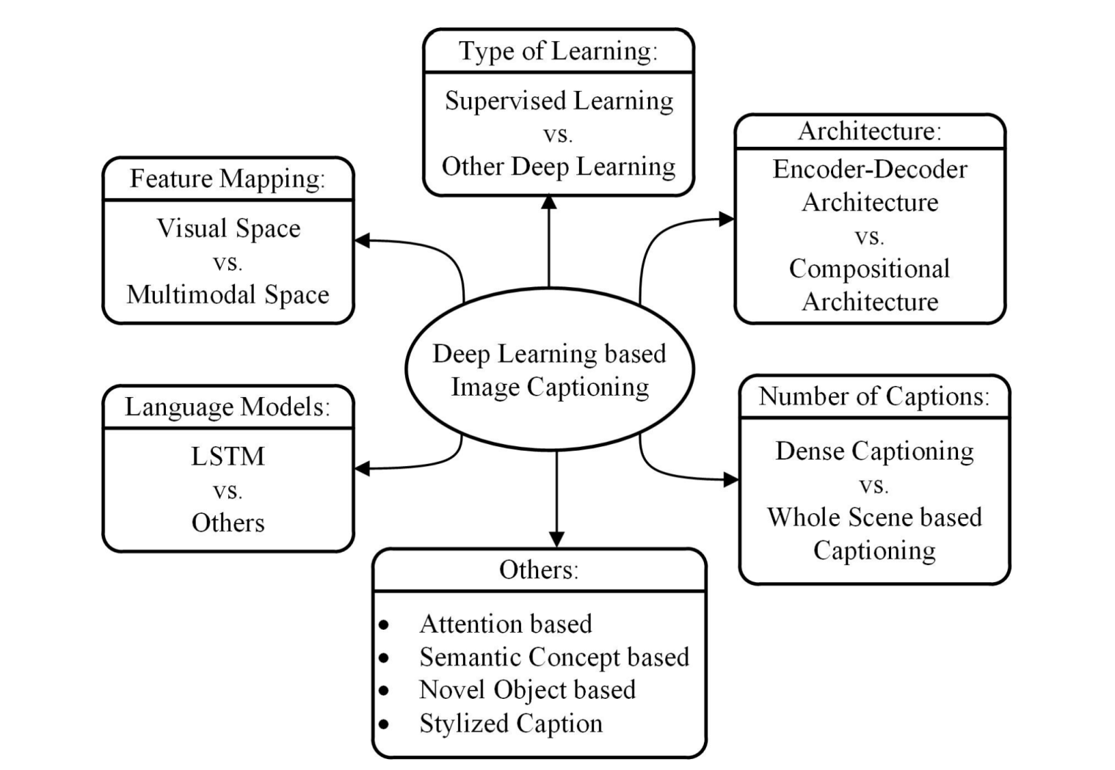
WAYS OF USING DEEP LEARNING IN IMAGE CAPTIONING

Slide 15
TOOLS
PYTHON(Libraries like Pandas, Numpy, OpenCV, etc.)
Deep Learning(Techniques like CNN and RNN, etc.)
NLP(Natural Language Processing)(Techniques Like Computer Vision and TensorFlow, etc.)

Slide 16
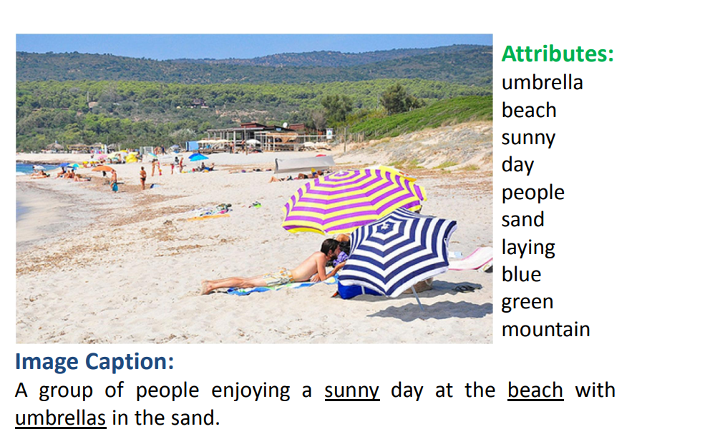
Final output of our Image Captioning would like image shown here.

Slide 17
DEPLOYMENT
We will be using Streamlit for deploying our project because of it advantages which are following:
Less code is needed
It embraces python and requires no HTML knowledge
Data caching simplifies and speed up computational pipelines
In case we are not comfortable with Streamlit, we will move to Django framework for deployment.

Slide 18
REFERENCE
https://cs224d.stanford.edu/reports/Thirman.pdf
https://www.analyticsvidhya.com/blog/2018/04/solving-an-image-captioning-task-using-deep-learning/
https://towardsdatascience.com/image-captioning-in-deep-learning-9cd23fb4d8d2#:~:text=What%20is%20Image%20Captioning%3F&text=Image%20Captioning%20is%20the%20process,Vision%20to%20generate%20the%20captions.
https://data-flair.training/blogs/python-based-project-image-caption-generator-cnn/

Slide 19
DATA SOURCE
https://datasetsearch.research.google.com/search?query=Image%20captioning&docid=VRjNikK7JkYYGV33AAAAAA%3D%3D
https://cocodataset.org/#download
https://machinelearningmastery.com/develop-a-deep-learning-caption-generation-model-in-python/ (Flickr8k dataset)

Slide 20
THANK YOU!

